Slide 1
Compiler
Program related to the compiler:
Atom > reserved words and symbols are used in a computer language by the user.
Ex:
X = 5
Atom > is a free and open-source text and source code editor developed by GitHub.

Slide 2
Compiler
Program related to the compiler:
interpreter.
Assembler.
Macro Assemblers.
Linkers.
Loaders
Preprocessors.
Editors.
Smart editors.
Debuggers.
IDEs.
Profilers.
Project managers.

Slide 3
Compiler
Program related to the compiler:
interpreter.
Translate line by line.
2) Assembler.
Translate assembly language to machine code.
Ex:
MOV AL,20
3)Macro assemblers
Some are similar to assembly language but more powerful than assembler.

Slide 4
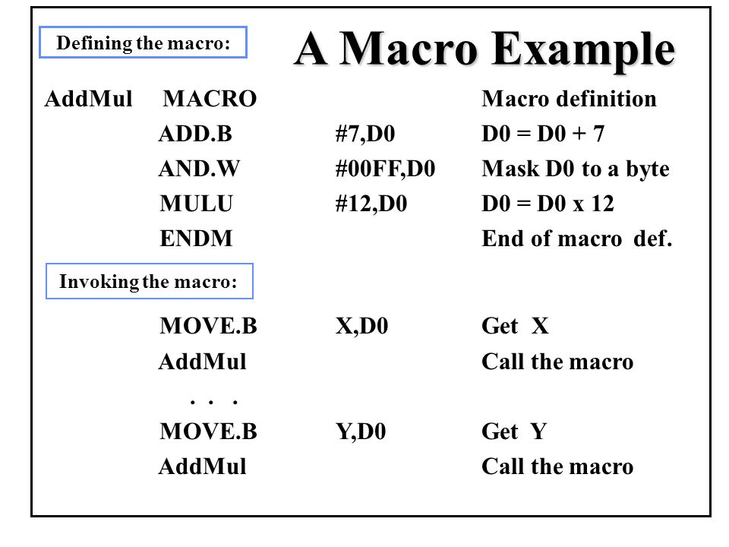
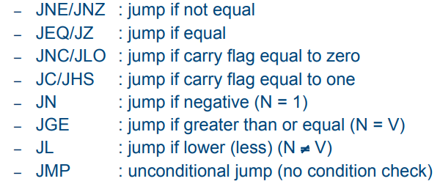
Compiler

Slide 5
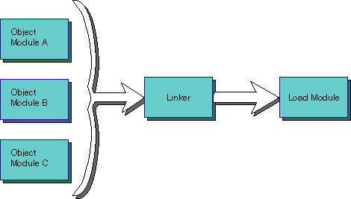
Compiler
Program related to the compiler:
4)Linkers
Combine objects to produce an executable module.

Slide 6
Compiler
Program related to the compiler:
5)Loaders
Load executable modules into memory and launch execution.
6)Preprocessors
Usually, input and output are source code sometimes in the first phase of the compiler
7)Editors
Allow the user to create and update source code.

Slide 7
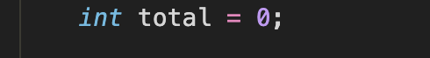
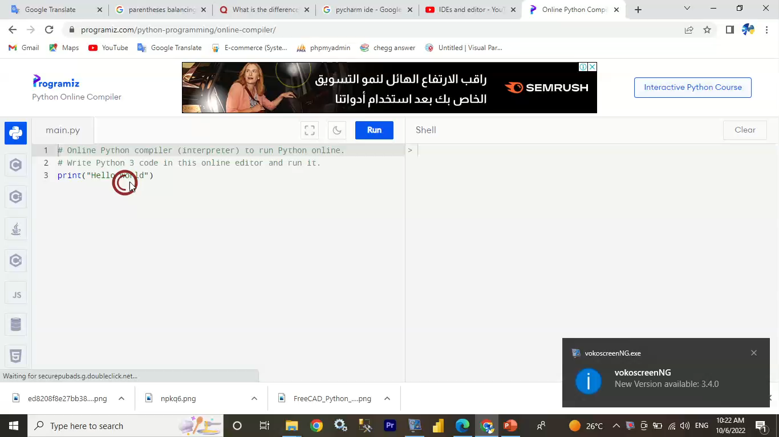
Compiler
Program related to the compiler:
8)Smart editor
Include syntax coloring and parentheses balancing.

Slide 8
Compiler
Program related to the compiler:
9) Debuggers
Test for errors or to help determine the cause of an error.
10) IDEs
Integrated development environments.
11) Profilers
Technique for rearrangement instructions based on statistical information.

Slide 9
Compiler
Program related to the compiler:
12) Project managers
Help software managers to manage modules like building reports.

